Slide 1
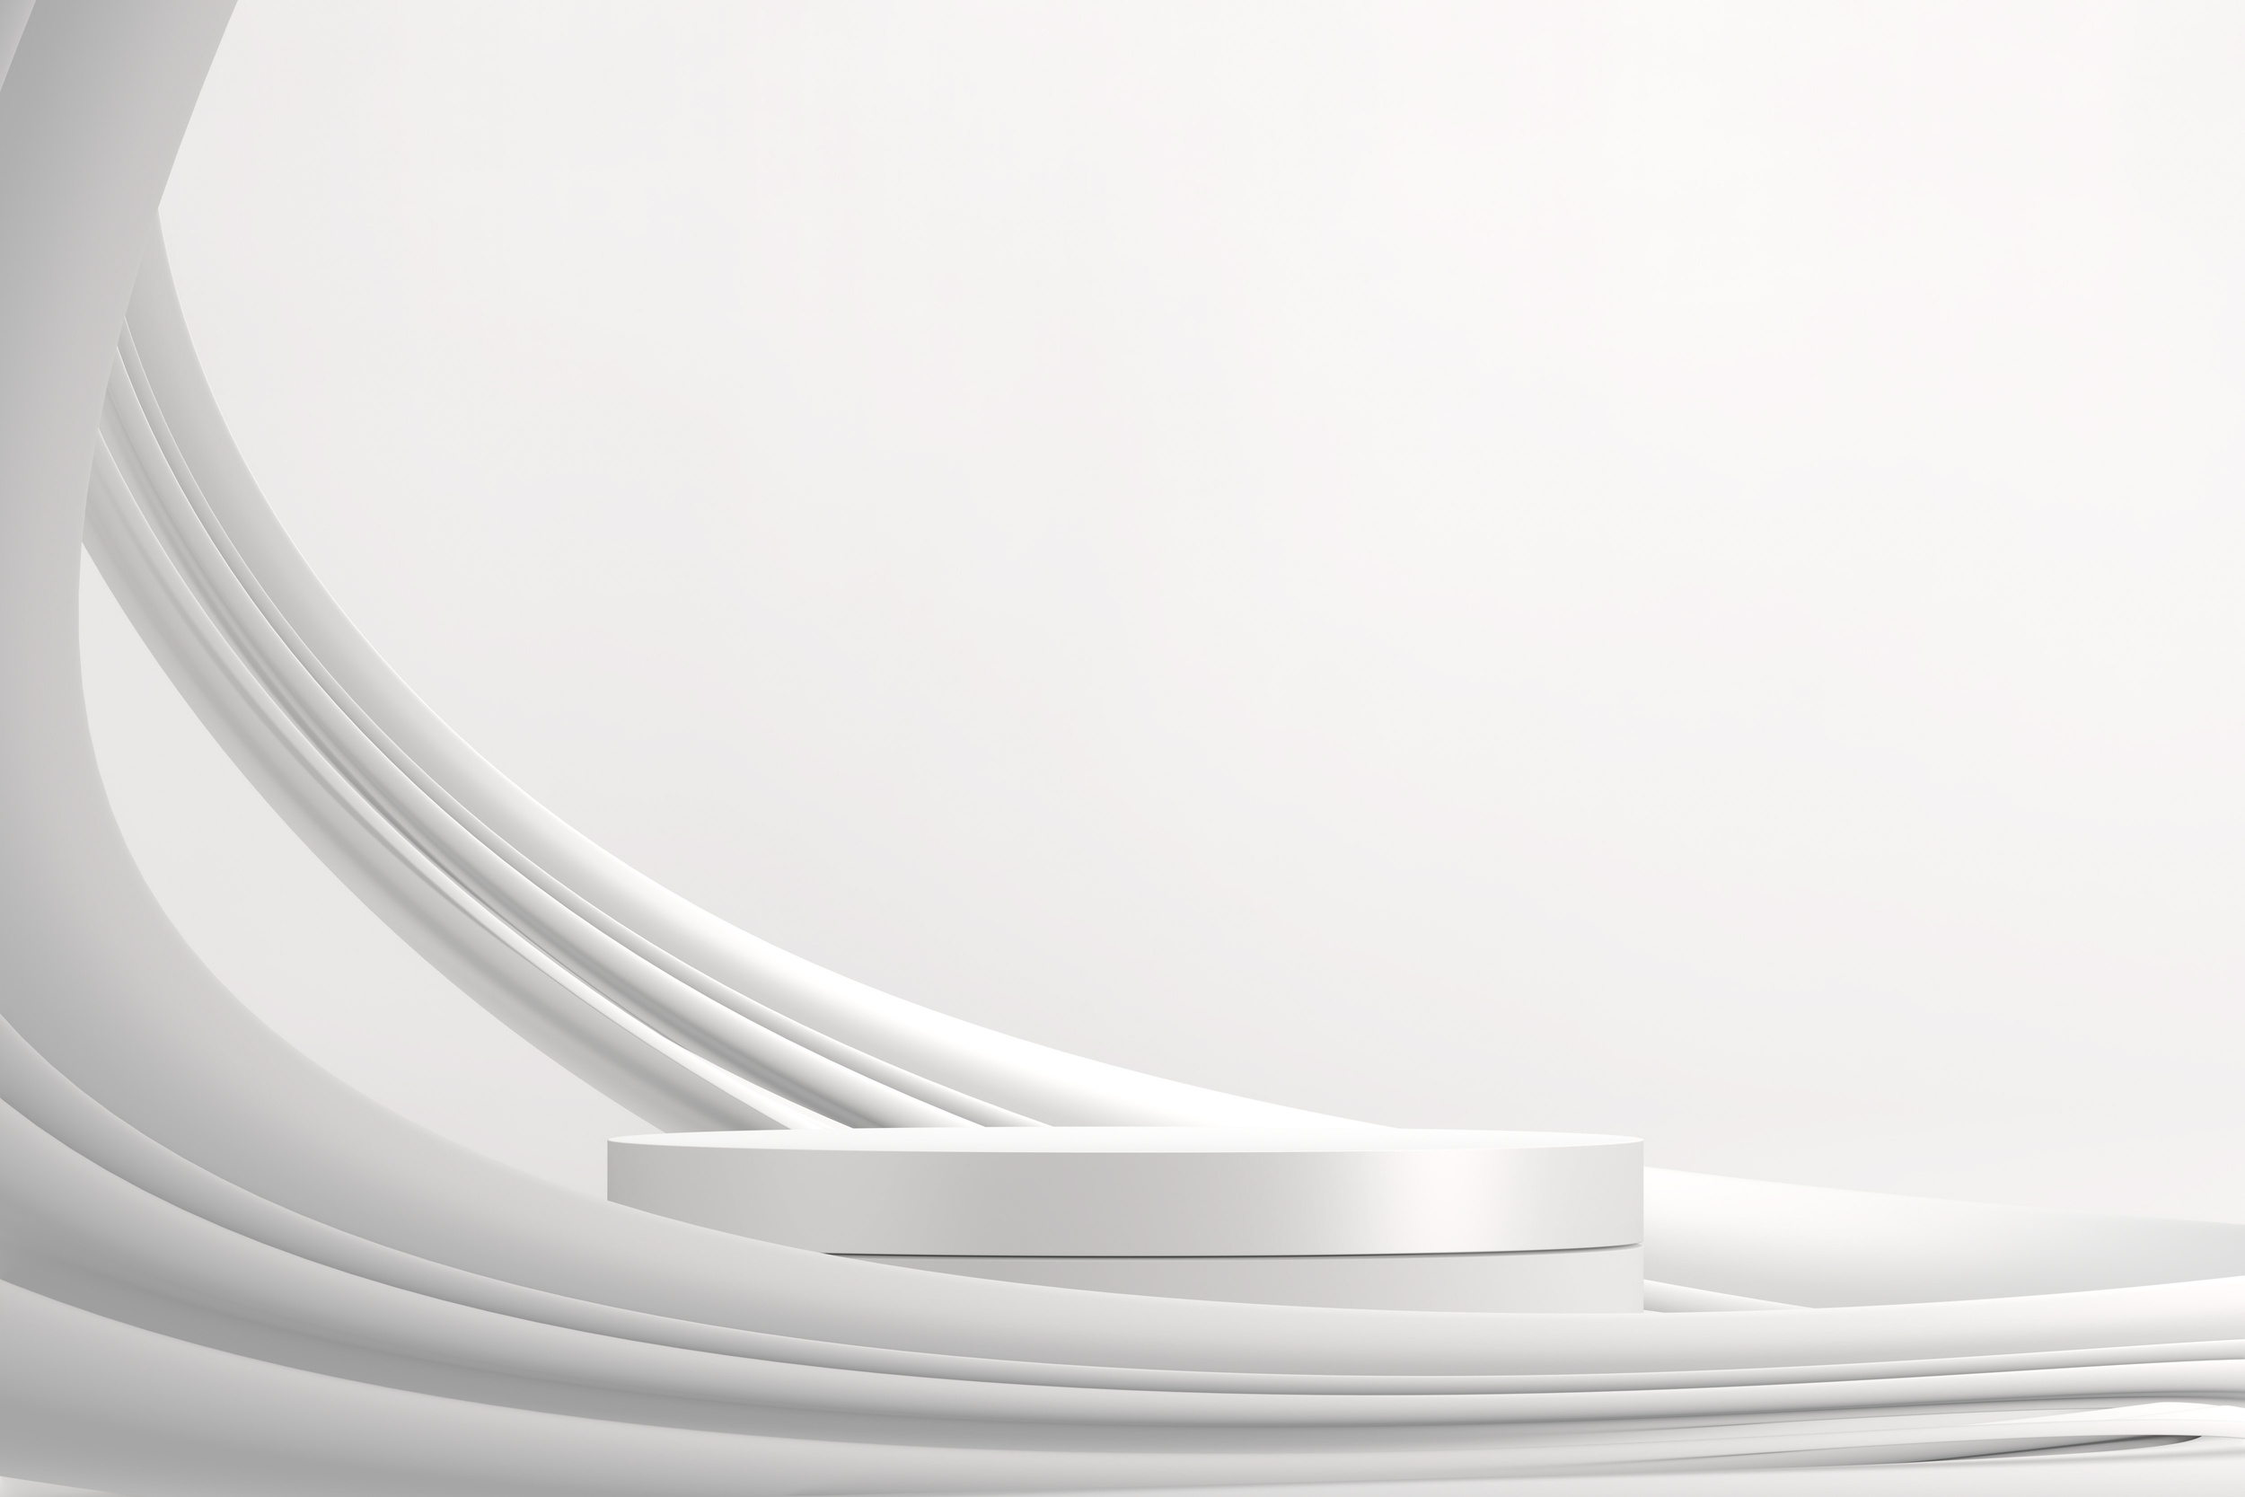
WELLBOT – Global Wellness Assistant Chatbot
Team Members:
1. Meghana
2. Aishwarya
3. Akash Rawat
4. Gopichand
Under the Guidance of
Mrs. Santhiya Krishnasamy

Slide 2

Introduction
WellBot is a multilingual, AI-powered chatbot designed to promote global wellness.
It democratizes access to reliable, non-diagnostic health and self-care information.
By combining conversational AI with personalized insights, it empowers proactive health management.
The assistant focuses on improving accessibility, engagement, and awareness in wellness.
Its goal is to bridge technology and human well-being through seamless conversation.

Slide 3
Abstract
WellBot is an AI/ML-driven chatbot acting as a 24/7 wellness guide.
It consolidates advice on fitness, diet, sleep, and mental health into one interface.
Using NLP and Machine Learning, it provides context-aware recommendations.
The hybrid recommendation engine ensures personalized wellness guidance.
It bridges the gap between clinical expertise and daily self-care.

Slide 4
Proposed System
The system integrates NLP and ML for multilingual, personalized health assistance.
A hybrid recommendation model delivers content based on user context and preferences.
It covers key wellness areas: nutrition, fitness, mental health, and sleep.
Data privacy and inclusivity are core principles for a global user base.
The architecture ensures scalability, engagement, and user trust.

Slide 5
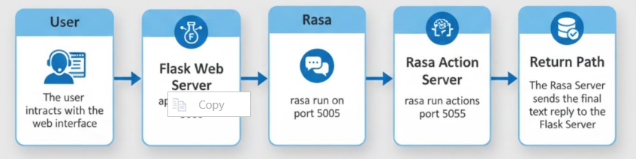
System Architecture

Slide 6
Milestone 1 – Authentication & Profiles
Implemented secure login, registration, and profile creation with Flask & SQLAlchemy.
Used JWT-based authentication for session handling and data protection.
Passwords are encrypted using hashing techniques for user security.
Frontend logic validates session tokens and prevents unauthorized access.
This milestone built the foundation for user-specific wellness personalization.

Slide 7
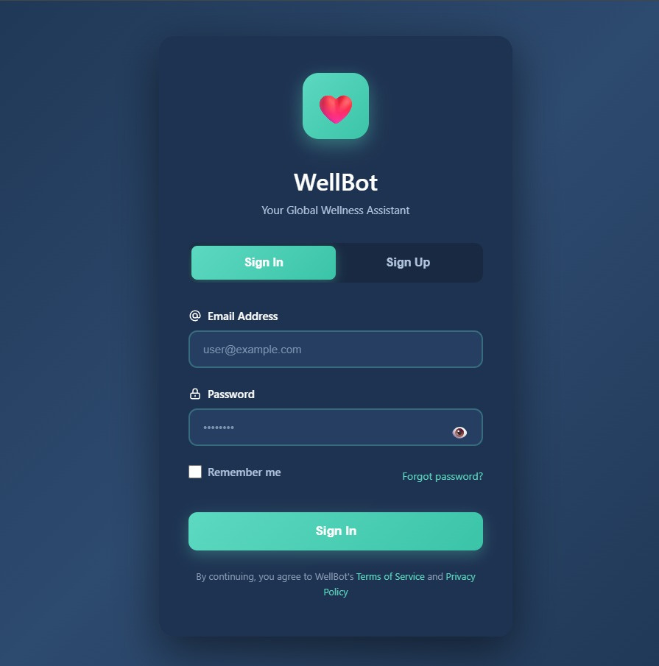

Slide 8
Milestone 2 – Chatbot Integration & Web UI
Integrated Rasa chatbot with Flask-based web UI.
The NLU model identifies user intents and entities in English and Hindi.
Structured HealthKnowledge database stores multilingual wellness content.
Admin tools enable easy CSV imports for data updates.
Custom Rasa actions retrieve relevant knowledge dynamically.
This milestone completed the intelligent chatbot workflow.

Slide 9
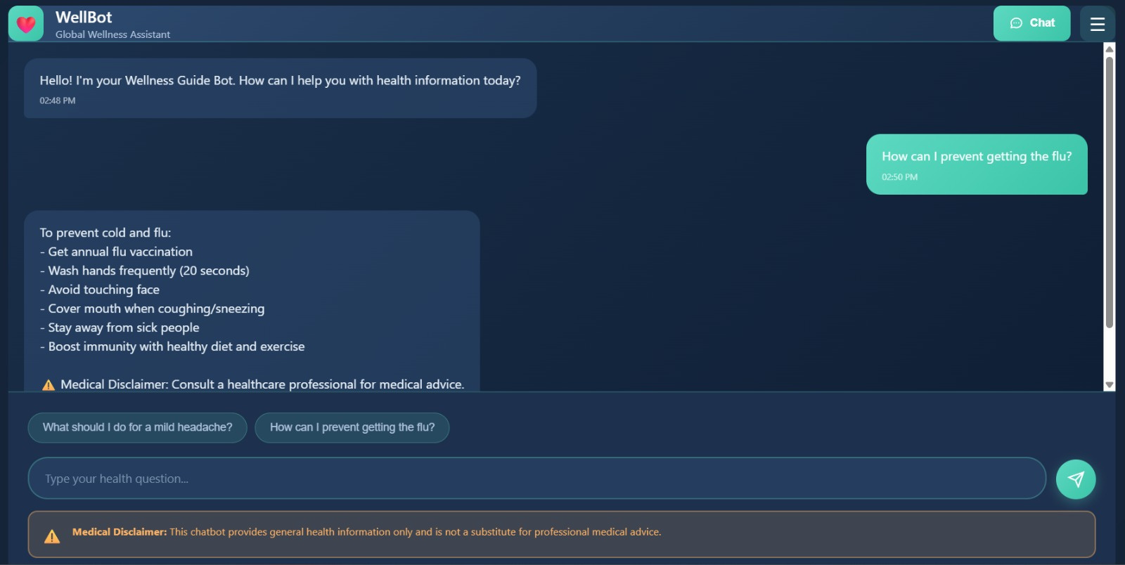

Slide 10
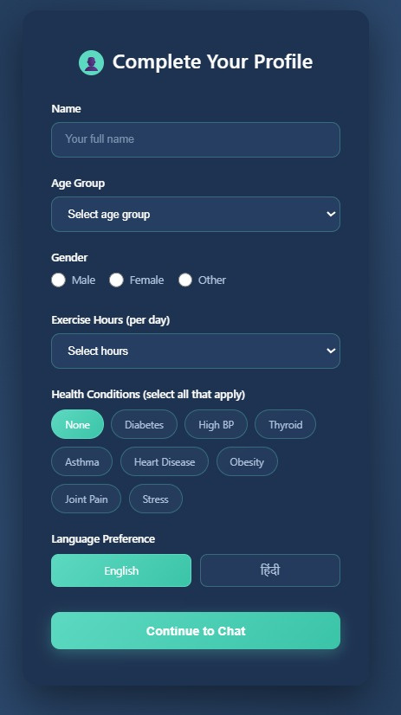

Slide 11
Milestone 3 – Advanced NLP & Multilingual Features
Expanded the knowledge base to 100+ wellness topics.
Implemented safety disclaimers for medical boundaries.
Added full Hindi language support for global inclusivity.
Dynamic language selection adapts to user preferences.
Enhanced NLU with advanced entity extraction for personalized replies.
This milestone improved contextual accuracy and accessibility.

Slide 12
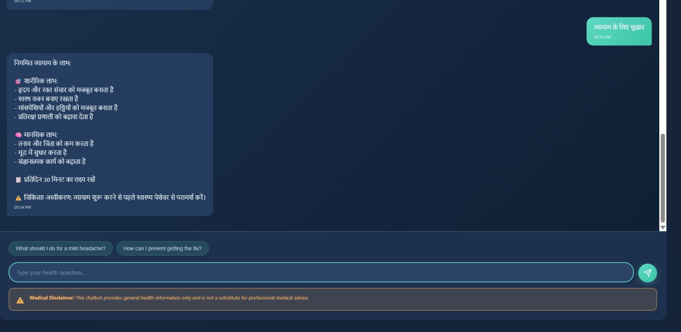

Slide 13
Milestone 4 – Admin Dashboard & Optimization
Developed a secure admin dashboard for data management.
Admins can add, edit, and delete knowledge base entries.
Integrated user analytics for tracking intent and feedback trends.
Added feedback system (thumbs up/down) for content evaluation.
Optimized backend sessions, logging, and error handling.
UI redesigned with modern layout and responsive interface.

Slide 14
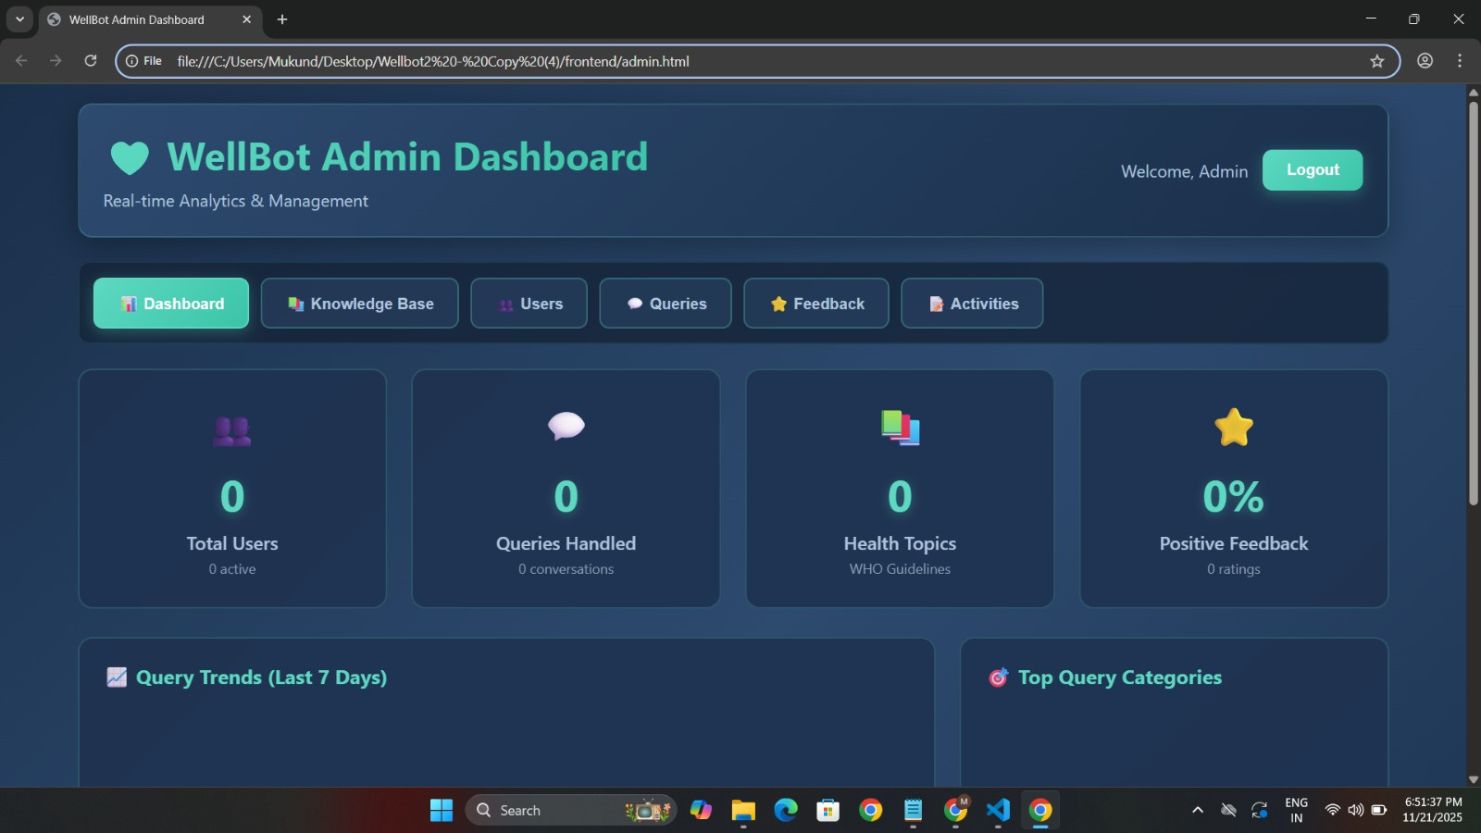

Slide 15
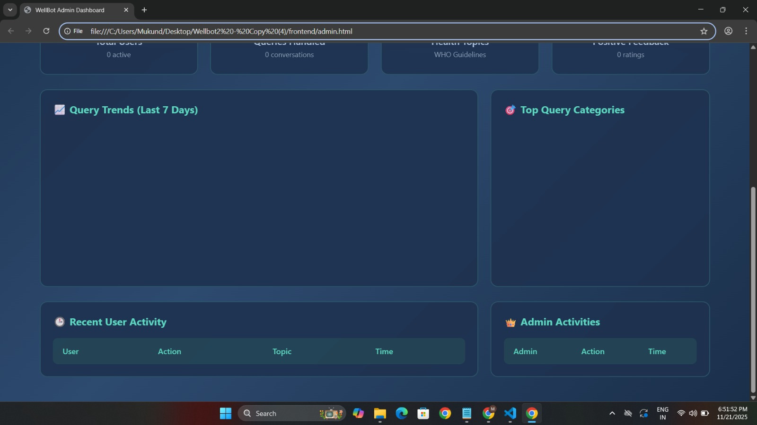

Slide 16
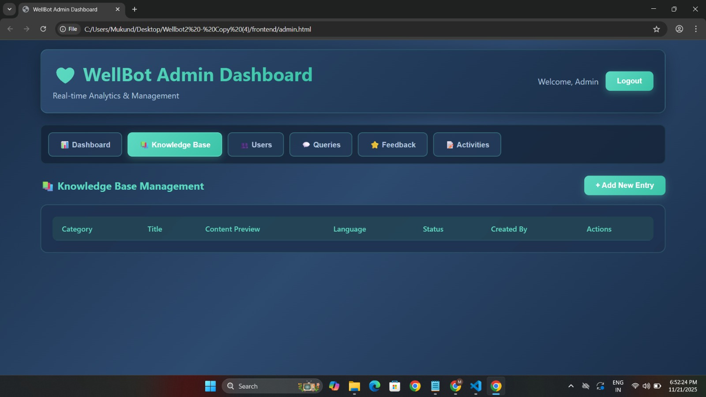

Slide 17
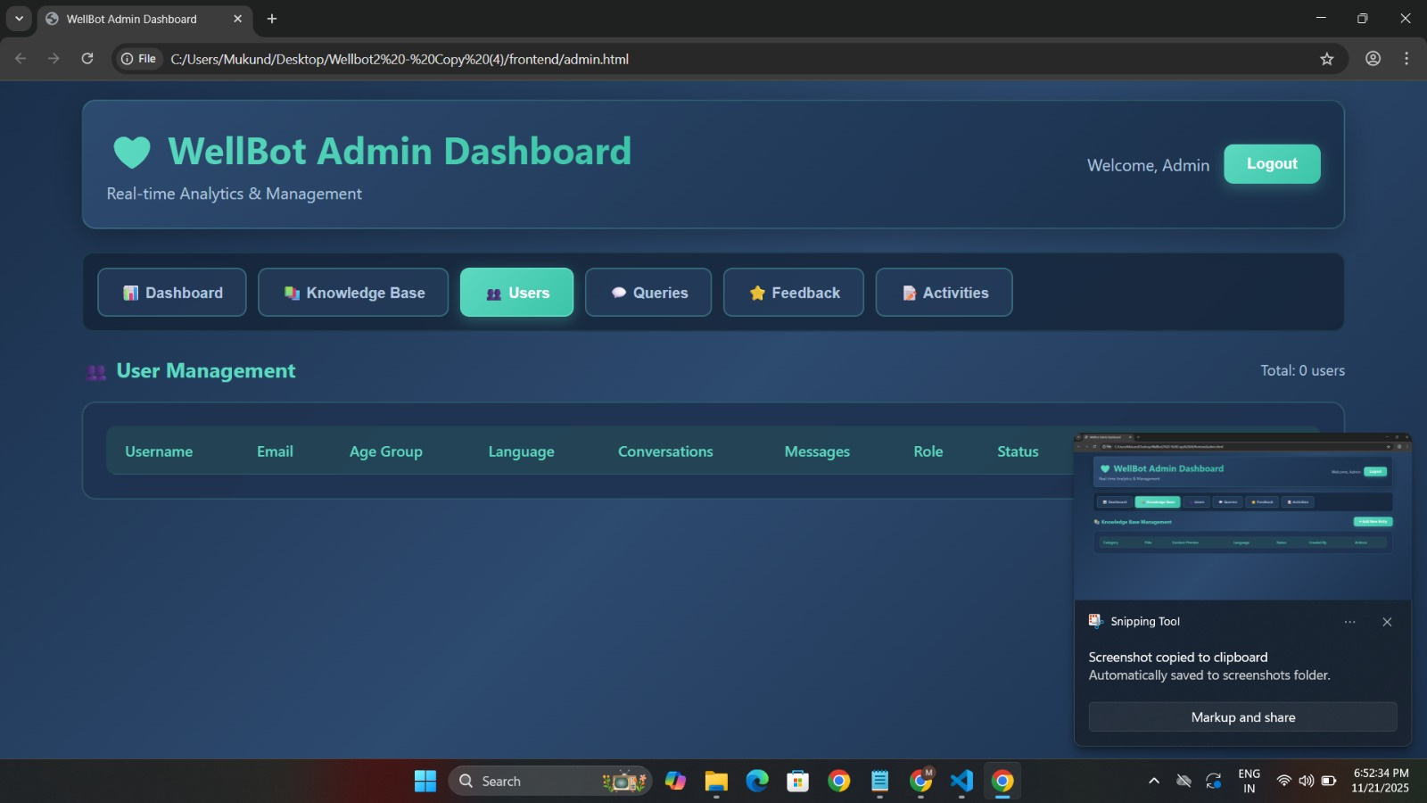

Slide 18
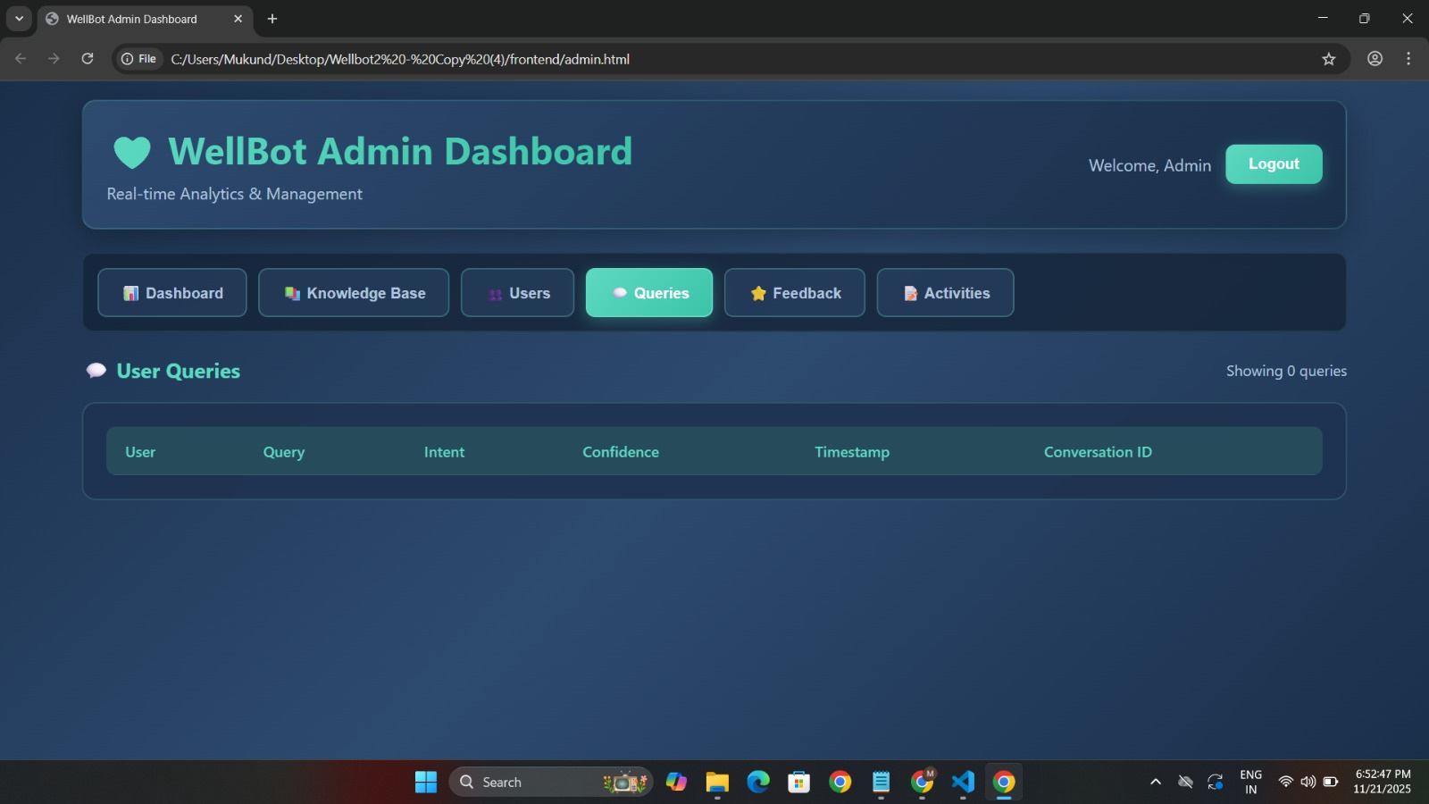

Slide 19
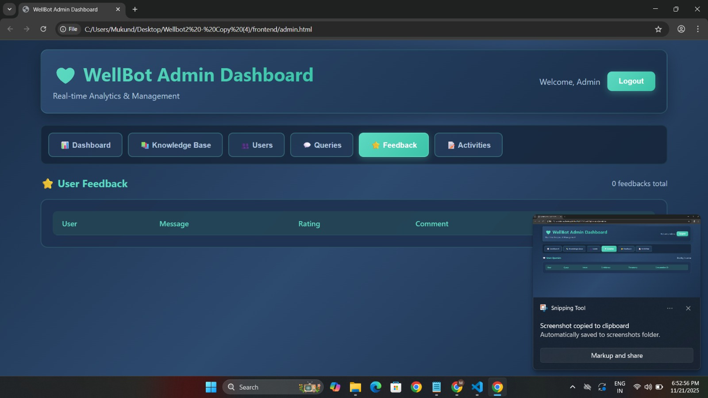

Slide 20
Technologies Used
Built on a modular open-source stack for scalability and reliability.
Backend: Flask (Python) for routing and API management.
AI Engine: Rasa for NLP, entity recognition, and dialogue control.
Authentication: Flask-JWT-Extended for token-based security.
Database: SQLite with SQLAlchemy ORM for smooth operations.
Frontend: HTML, CSS, JavaScript for interactive UI.
Ensures flexibility, modularity, and seamless integration.

Slide 21
Output – Expected Outcomes
Delivers personalized daily wellness plans (diet, fitness, sleep).
Provides stress and emotion-aware advice.
Increases engagement through intelligent interaction.
Scales globally with multilingual support and adaptive AI.

Slide 22
Future Scope
Introduce AR/VR meditation for immersive stress relief.
Enable AI-based image and voice diagnostics for early health checks.
Adopt blockchain for secure storage of sensitive health data.

Slide 23
Conclusion
WellBot demonstrates how AI can transform personal wellness.
It combines secure architecture with multilingual intelligence.
Supports self-care and awareness through accessible design.
Built with scalable, open-source technologies for growth.
Future versions will expand AI, security, and immersive health tools.

Slide 24
Thank You
Presented by:
Meghana
Aishwarya
Akash Rawat
Gopichand

